Slide 1
NEB FESTIVAL SIDE EVENT ‘Designing fruitful cooperation for shaping the New European Bauhaus’

Slide 2
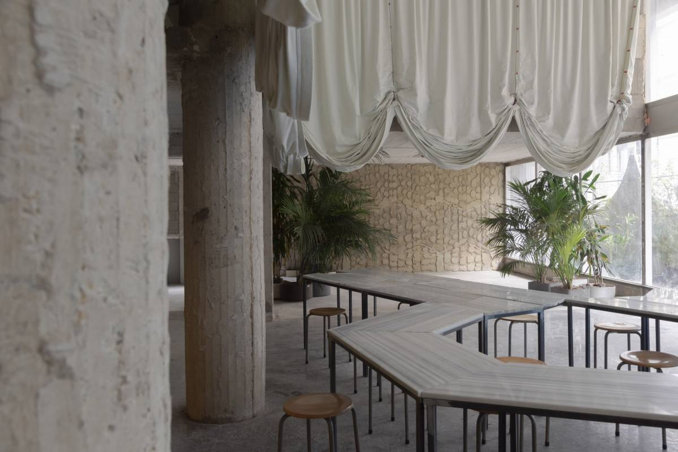
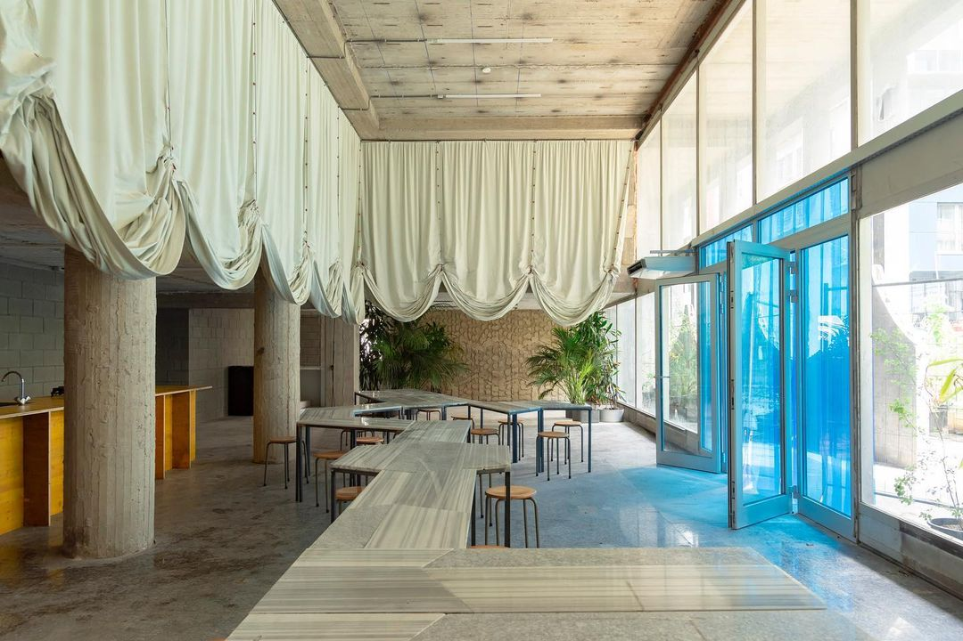
09/06: evening RECEPTION
This reception will take place at the STAM Europa, from 18:30 to 21:00 pm and will consist of:
An exhibition of NEB projects (Habiter 2030, Painovoima ry – a carbon neutral island project)
A networking evening
→ Do you have NEB projects that you would like to showcase?
NEB Festival Side event ‘Designing fruitful cooperation for shaping the New European Bauhaus’

Slide 3
10/06: workshops
The workshop session will take place from 9:00 am to 12:30 pm and will gather participants with similar interests and problems, in order to favour synergy and future cooperation.
The themes of the workshops are the following:
Circular construction and urban renovation
Reconnecting with nature: focus on water cycle, sustainable mobility, green infrastructures
Design as a tool for social changes
NEB Festival Side event ‘Designing fruitful cooperation for shaping the New European Bauhaus’

Slide 4
10/06: workshops planning
9h00-9h15: Welcome
9h15-9h45: Intervention of the Commission about the future perspectives of the NEB and the upcoming calls and funding opportunities
9h45-10h45: Workshop part 1 (in split sessions)
Icebreaker (15min)
Analyse of the klaxoon board and report of the workshop of 24 february (15min)
Selection of 3 topics on which futur cooperation projects can be build
10h45-11h00: Break
11h00-12h00: Workshop part 2 (in split sessions)
Try to go as far as possible in the reflexion about futur cooperation projects (Short - mid - long term)
Stakeholders on local, regional, european scale
Links with NEB philosphy
Funding opportunities in the framwork of NEB
12h00-12h30: Restitutions - conclusions – next steps
NEB Festival Side event ‘Designing fruitful cooperation for shaping the New European Bauhaus’

Slide 5
To do LIST- deadlines reminder
May 18th:
Sending of the invitation to our partners, colleagues and local/regional actors
Before May 27th:
Validation of the animator for the workshop “Design as a tool for social change”
Validation of speakers from the European Commission
Sending documents to the animators (framework note, conclusions of last workshops, klaxoon), methodology)
NEB Festival Side event ‘Designing fruitful cooperation for shaping the New European Bauhaus’

